Slide 1
ENGLISH 4U
Durley Melissa Alzate Cardona
Maria José Henao Mejia
Valentina Muñoz Salazar

Slide 2
Table of contents
01
01
02
03
04
Breads
Cakes
Recipes
Toppings
You can describe the topic of the section here
You can describe the topic of the section here
You can describe the topic of the section here
You can describe the topic of the section here

Slide 3
Definición del problema
01
Se ha evidenciado que los estudiantes de los grados tercero y cuarto presentan dificultades para aprender una segunda lengua.
¿Por qué pasa esto?
¡Se cree que esto es debido a que los niños no muestran un verdadero interés para aprender! probablemente porque a simple viste les parece aburrido y difícil.

Slide 4
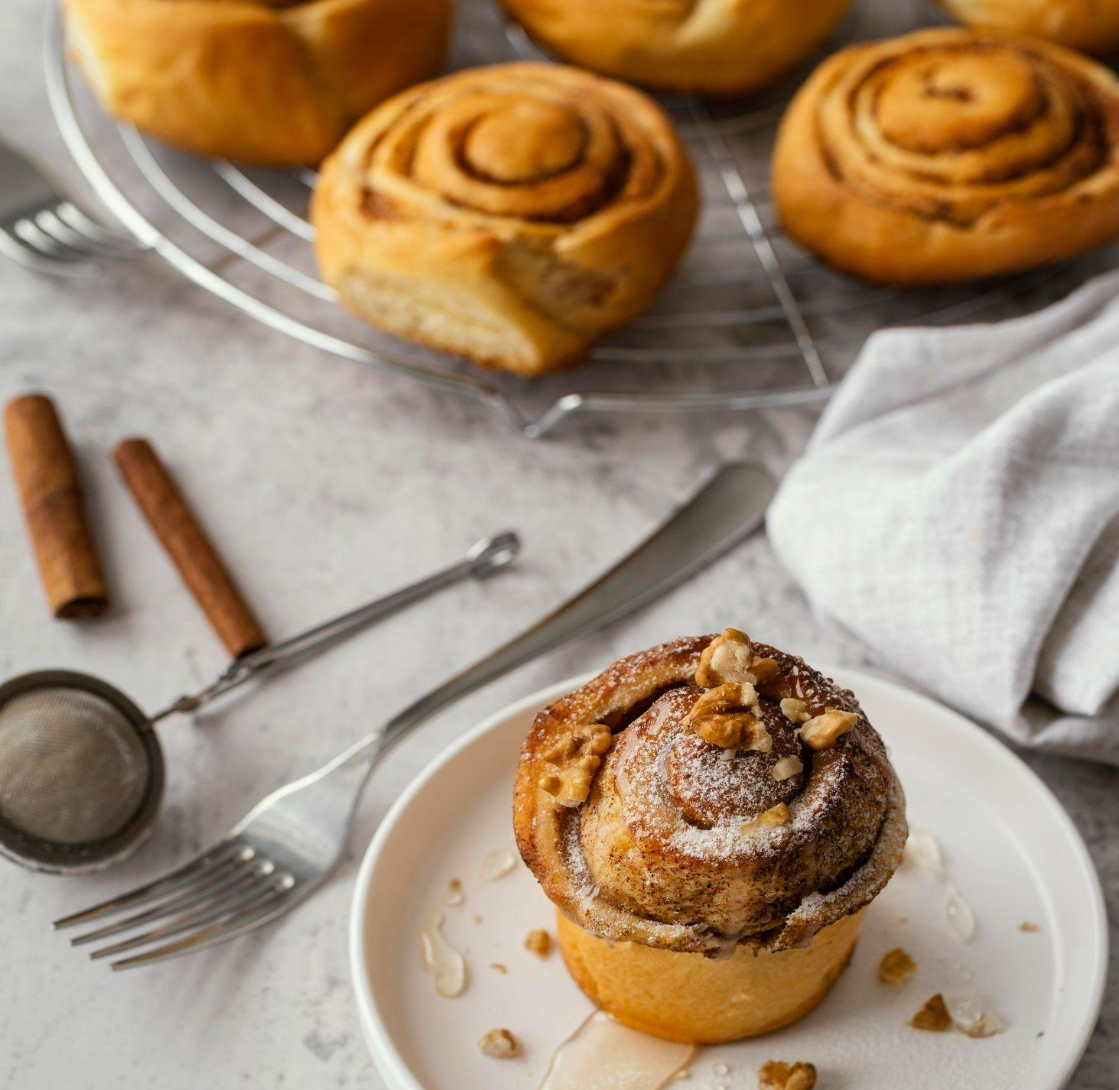
¿Para quienes está dirigido el proyecto?
Este proyecto está dirigido a estudiantes de la institución educativa José Antonio galán de los grados tercero y cuarto, que oscilan entre 8 a 10 años.

Slide 5
Visión
Misión
Como visualizamos que va a estar el proyecto
“Se espera que para x fecha el proyecto tenga x distribución en tanos colegios y que sirva para tantos estudiantes”
Como lo pensamos hacer

Slide 6
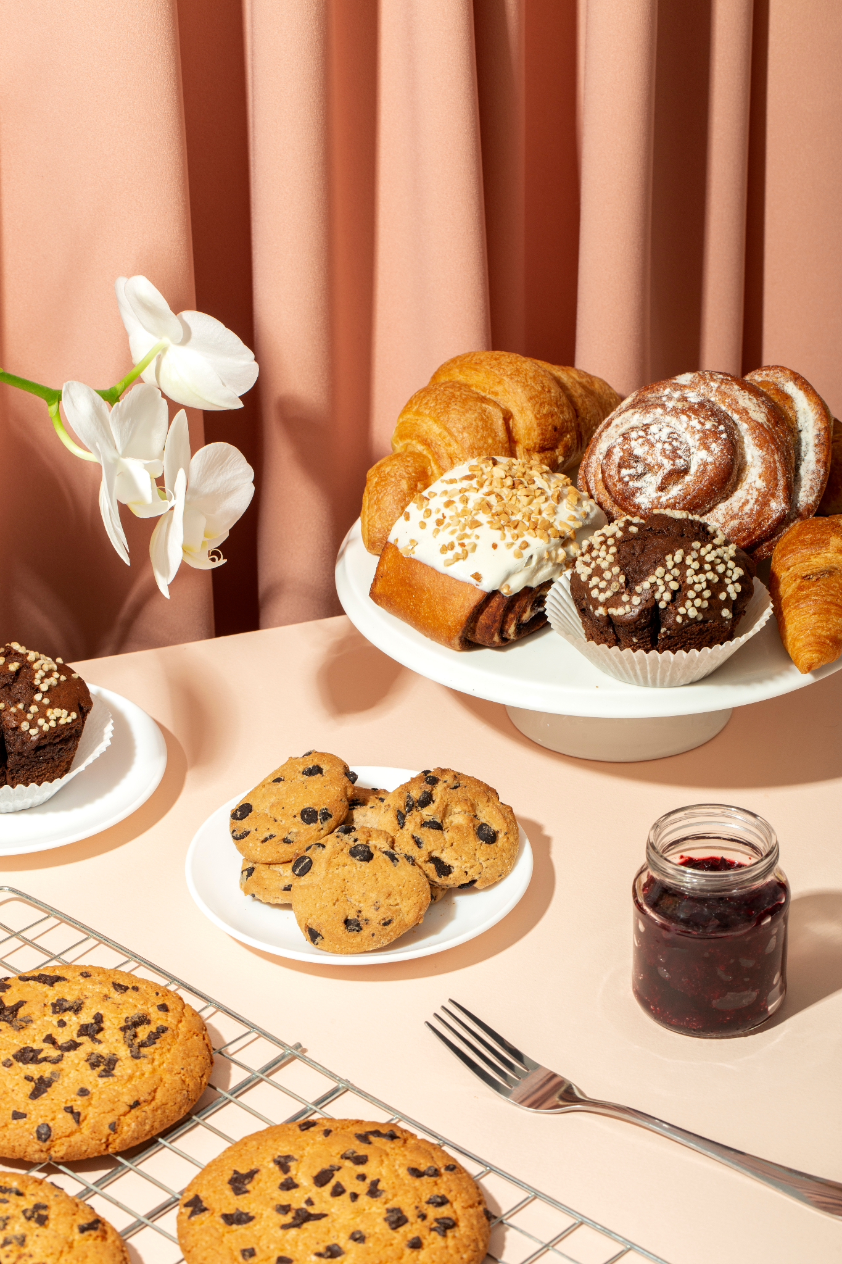
A picture always reinforces the concept
Images reveal large amounts of data, so remember: use an image instead of a long text. Your audience will appreciate it

Slide 7
Essential kitchen appliances
Oven
Stand mixer
Hand mixer
Venus has a beautiful name and is the second planet from the Sun
Mercury is the closest planet to the Sun and the smallest one
Despite being red, Mars is actually a cold place. It’s full of iron oxide dust

Slide 8
Objetivos
Mix it up
Have fun
Don't rush !
Be patient
Mercury is the closest planet to the Sun and the smallest of them all
Despite being red, Mars is actually a cold place. It’s full of iron oxide dust
Jupiter is a gas giant and the biggest planet of the Solar System
Venus has a beautiful name and is the second planet from the Sun

Slide 9
Banana bread recipe
Ingredients
Step by step
Prep time: 45min
Difficulty: Easy
Dairy-free
Ripe bananas
Eggs
All purpose flour
Sugar
Soy milk
Butter
Baking powder
Mercury is the smallest planet of them all
Venus has very high temperatures
Earth is the only planet with rings
Jupiter is the biggest planet
Saturn is the only planet with rings
Neptune is very far from the Sun
Pluto is now considered a dwarf planet

Slide 10

Computer mockup
You can replace the image on the screen with your own work. Right-click on it and then choose "Replace image" (in Google Slides) or "Change Picture" (in PPT) so you can add yours"

Slide 11
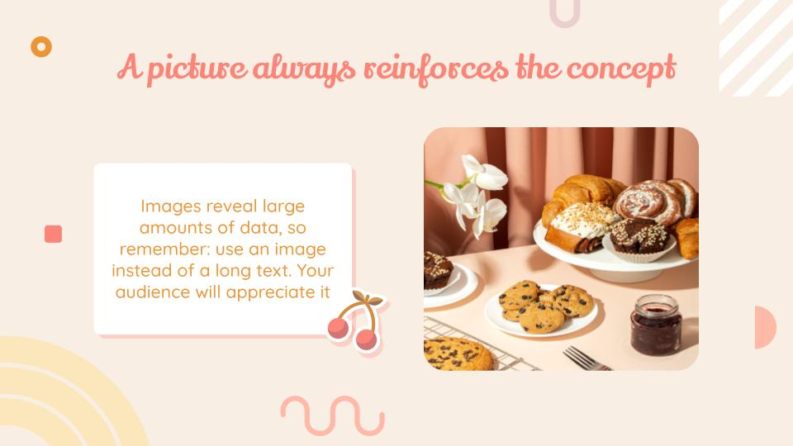
Tablet mockup
You can replace the image on the screen with your own work. Right-click on it and then choose "Replace image" (in Google Slides) or "Change Picture" (in PPT) so you can add yours"

Slide 12
Thanks
Do you have any questions?
addyouremail@freepik.com
+91 620 421 838
yourwebsite.com
Please keep this slide for attribution

